Slide 1
Mississippi Data Warehouse: Source Record Identifiers
03/11/2020

Slide 2
What is a Source Record Identifier (SRI)?
Unique identifier for a record
Can be based upon information that should not change
Can be arbitrary
Cannot be changed once created
Must be unique within table
In the Data Warehouse, this is likely the Unique Identifier from the source EHR.
Providers must provide a SRI

Slide 3
Source Record Identifiers in the Data Warehouse
Object | Primary Identifier | Referenced Identifiers
Provider | Source Record Identifier
Provider Site | Source Record Identifier
Provider Site Phone | Source Record Identifier
Provider Client | Source Record Identifier | Provider Source Record Identifier
Treatment Episode | Source Record Identifier | Provider Source Record Identifier | Client Source Record Identifier
Admission | Source Record Identifier | Provider Site Source Record Identifier
Discharge | Source Record Identifier
Functional Assessment | Source Record Identifier
Performance Outcome Measure | Source Record Identifier
UsedSubstance | Source Record Identifier
Diagnosis | Source Record Identifier

Slide 4
SRI Examples
SRI Good Examples
Serial ID: 000134920491
GUID: 4d33d653-235f-48f9-b288-cecdac4f414d
Based on Source Data: brockmanjamesdavid|020120201423
SRI Bad Examples:
Last Name (not unique)

Slide 5
What are SRIs for?
Data Update vs Data Creation
Associating Entities

Slide 6
Data Update vs Creation
Example: Existing Data
SRI | Provider SRI | Last Name | First Name | DOB
0000149 | 000014 | Smith | Gerald | 1/2/1978
0000150 | 000014 | Jones | Patricia | 1/4/1980
0000151 | 000014 | Bunny | Bugs | 1/3/1948
0000152 | 000015 | Fudd | Elmer | 1/4/1948

Slide 7
Data Update
Example: Data Update
SRI | Provider SRI | Last Name | First Name | DOB
0000149 | 000014 | Smith | Gerald | 1/2/1978
0000150 | 000014 | Jones | Patricia | 1/4/1980
0000151 | 000014 | Bunny | Bugs | 1/3/1948
0000152 | 000015 | Fudd | Elmer | 1/4/1948
Data in Data Warehouse
Which Record?
What is the update?
New Data from XML
SRI | Last Name
0000150 | Williams
Record 150 is updated with a new last name. Because this is an update, only the new information needs to be provided.

Slide 8
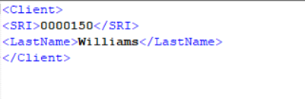
Data Update in XML

Slide 9
Data Creation
Example: Data Creation
SRI | Provider SRI | Last Name | First Name | DOB
0000149 | 000014 | Smith | Gerald | 1/2/1978
0000150 | 000014 | Williams | Patricia | 1/4/1980
0000151 | 000014 | Bunny | Bugs | 1/3/1948
0000152 | 000015 | Fudd | Elmer | 1/4/1948
Data in Data Warehouse
New Data from XML
SRI | Provider SRI | Last Name | First Name | DOB
0000153 | 000015 | Duck | Daffy | 1/2/1978
Record 153 is added to the Data Warehouse.

Slide 10
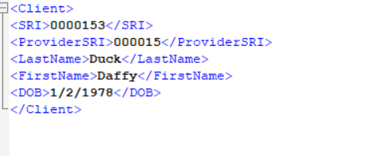
Data Creation in XML

Slide 11
SRI and Relationships
Provider Clients
SRI | Provider SRI | Last Name | First Name | DOB
0000149 | 000014 | Smith | Gerald | 1/2/1978
0000150 | 000014 | Jones | Patricia | 1/4/1980
0000151 | 000014 | Bunny | Bugs | 1/3/1948
0000152 | 000015 | Fudd | Elmer | 1/4/1948
0000153 | 000015 | Duck | Daffy | 1/2/1978
Providers
SRI | Provider Name
000014 | Provider A
000015 | Provider B

Slide 12
SRI and Relationships 2
Provider Clients
Providers
SRI | Provider SRI | Last Name | First Name | DOB
0000149 | 000014 | Smith | Gerald | 1/2/1978
0000150 | 000014 | Jones | Patricia | 1/4/1980
0000151 | 000014 | Bunny | Bugs | 1/3/1948
0000152 | 000015 | Fudd | Elmer | 1/4/1948
0000153 | 000015 | Duck | Daffy | 1/2/1978
SRI | Provider Name
000014 | Provider A
000015 | Provider B
Provider Treatment Episode
SRI | Client SRI | Provider SRI | Residence County | Date of First Contact
0001941 | 0000152 | 000015 | 1321.4 | 1/7/2020

Slide 13
Advanced Topics
Referencing a Source Record Identifier instead of creating a full Performance Outcome Measure. (See XML)

