Slide 1
Mississippi
WITS SOR - SUPRT Training
Notes:
Hello and welcome to the FL DCF WITS SOR 3 Training.
Note for facilitators: speaking points are in regular font. Directional and background information is in italics.​

Slide 2

Introductions
Notes:
Introduce yourself:
Provide name, who you are with, and your role at the company.
Go around the room and have the learners do the same.
(After introductions) Before we get into today’s topics, please know that we are all here to learn. If you have any questions, please do not hesitate to ask. (If virtual training, provide instruction on how attendees can raise their hand.)

Slide 3

Agenda
SUPRT Assessments
SOR Workflow
Reassessment
Annual Assessment
Closeout Assessment
Discharge
GPRA Transition to SUPRT

Slide 4
SUPRT Assessments
Notes:
Let’s start by talking about the SUPRT assessments.

Slide 5
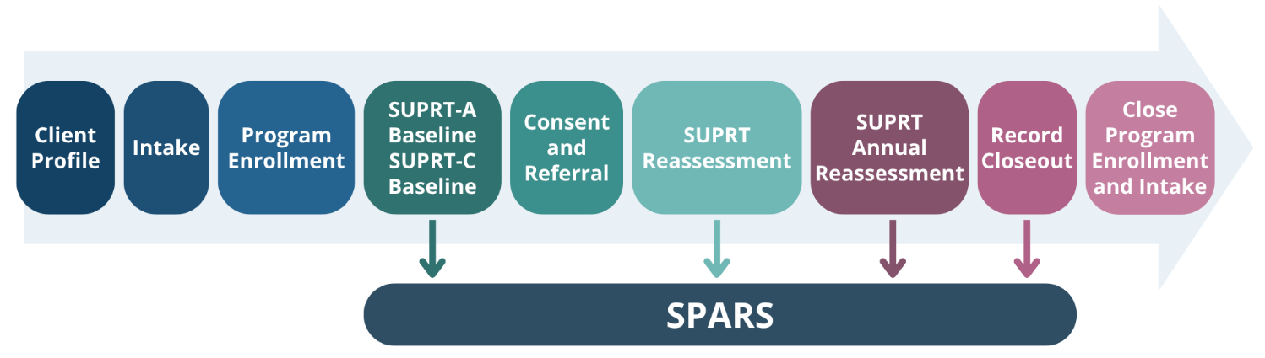
SOR Workflow with SUPRT Assessments
Notes:
This is a graphic showing the SOR workflow with the SUPRT assessments. As you can see, when the SUPRT assessments are completed is similar to when the GPRA was completed in the workflow.
Client profile – 1st search for the client, then add the client if they do not exist
Intake starts the episode of care
SOR is tied to the program enrollment
Complete the baseline assessment.
Consent and Referral only if the client is moving around
Complete the reassessment.
Complete the annual assessment
Record closeout assessment
Close program enrollment and episode of care.

Slide 6
SUPRT Assessment Periods
Baseline
Completed within 30 days before or after first service
Client returns after closeout completed
Reassessment
Due 6 months after baseline assessment
Completion window – 30 days before or after baseline anniversary
Annual Assessment
Every 365 days after baseline
Completion window – 30 days before or after baseline anniversary
Closeout Assessment
No longer receiving services
Completed within 30 days of date services discontinued
Reassessment and Annual no longer needed
Notes:
The SUPRT assessments are completed at regular intervals.
The baseline is completed within 30 days before or after the client begins receiving services.
If the client returns for treatment after the closeout assessment is completed, a new baseline will need to be completed.
The reassessment is due 3 to 6 months after the baseline assessment. This due date is determined by the state.
This assessment must be completed within 30 days before or after the baseline’s anniversary.
For example, if a baseline assessment is completed on April 30th, the reassessment must be completed between June 30th and August 30th if the reassessment is due 3 months after the baseline assessment.
The reassessment is only completed once.
The annual assessment is completed 365 days after the baseline assessment and every 365 days after. So, if the baseline was completed on April 30th, 2026, the annual assessments will be due every April 30th starting in 2027.
The window for completing the assessment is 30 days before or after the anniversary date.
Using the same example, the annual assessment window opens on Marth 30th and closes on May 30th.
The closeout assessment is completed when the client is no longer receiving services.
The window for completing the closeout assessment is 30 days before or after the client stops receiving services.
Once the closeout assessment is completed, no other assessments are no longer required, even if the window for the annual or reassessment is currently open.

Slide 7
SUPRT Assessments
SUPRT-A
SUPRT-C
Completed by grantee staff
Always required
Completed by client or healthcare proxy
Always offered, but voluntary completion
Notes:
The SUPRT assessment is comprised of SUPRT-A and SUPRT-C assessments.
SUPRT-A is completed by the grantee/provider staff and must be completed for each assessment period.
SUPRT-C is completed by the client or their healthcare proxy. This assessment must be offered during each assessment period, but completion is voluntary.
There is additional information regarding these two assessments, which we will discuss now.

Slide 8
SUPRT-A Assessment
Not conducted as an interview
Consists of 6 sections
  Record Management – Completed at each assessment period
  Behavioral Health History – Not completed at Closeout
  Behavioral Health Screenings – Not completed at Closeout
  Behavioral Health Diagnosis – Not completed at Closeout
  Services Received – Not completed at baseline
  Demographics – Only completed at baseline and only if SUPRT-C not completed
    Even if SUPRT-C is started but not finished, F. Demographics not required
Notes:
The SUPRT-A is not conducted as an interview. This assessment is completed by the grantee using previously gathered information stored in the client’s existing records.
SUPRT-A is divided into 6 sections.
Record Management is completed at each assessment period.
Behavioral Health History is completed at each assessment period except for closeout.
Behavioral Health Screenings is completed at each assessment period except for closeout.
Behavioral Health Diagnosis is completed at each assessment period except for closeout.
Services Received is completed at each assessment period except for baseline.
Demographics – This is only completed at baseline and only if the client declined to complete SUPRT-C.
If the client starts completing the SUPRT-C but does not finish or change their mind, section F. Demographics is not required.

Slide 9
SUPRT-C Assessment
3 Versions based on age categories
  Adult (18+) – Offered at Baseline, Reassessment, and Annual and completed by client or proxy
  Youth (12-17) – Offered at Baseline and Reassessment and completed by client
  Child (5-17) – Offered at Baseline and Reassessment and completed by parent/proxy
Age category at Baseline used throughout all assessment periods
  Even if client ages out of category
4 Sections
  Record Management – Completed by grantee at all assessment points
  Demographics – Completed by client or proxy and only at Baseline
  Social Drivers of Health – Completed by client or proxy and only at Baseline and Reassessment
  Client Reported Core Outcomes – Completed by client or proxy at all assessment points, and only for the adult version
Notes:
The SUPRT-C assessment has 3 age-based versions.
The adult version is for clients aged 18 and older. This version is offered at baseline, reassessment, and annual assessment. It can be completed by the client or their proxy
The youth version is for clients aged 12-17. It is completed by the client and is offered only at baseline and reassessment.
The child version is for clients aged 5-17. It is completed by the parent or other proxy. It is only offered at baseline and reassessment.
The age version used at baseline is used throughout the client’s treatment even if they would age out.
For example, youth version is completed by a 17-year-old client. Next month, they turn 18. The SUPRT-C version will continue to be the youth version and follow the youth completion requirements throughout the client’s treatment.
The SUPRT-C has four sections. Records management is completed at all assessment points by the grantee.
Demographics is completed by the client or proxy and only at baseline.
Social drivers of health is completed by the client or proxy but only at baseline and reassessment.
Client reported core outcomes is completed by the client or proxy at all assessment points.

Slide 10
SOR Workflow
Notes:
Now that we have discussed the SUPRT assessment, let’s look at how you will complete the SOR workflow.

Slide 11
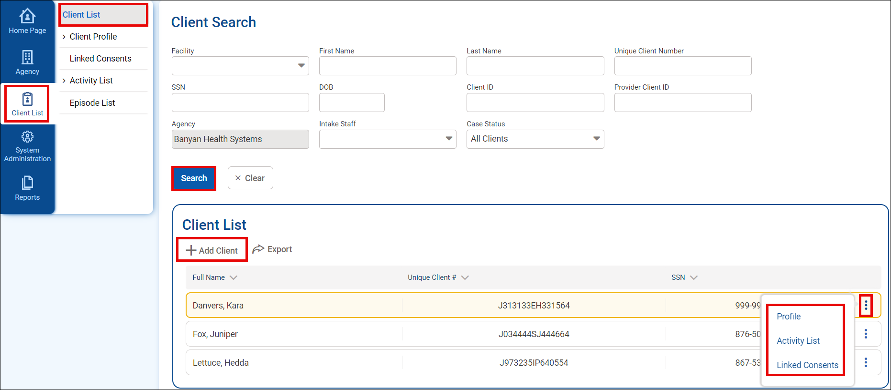
Client Record
Search for existing client before adding a record.
Quick access links for existing records.
Navigate to client record.
Add new client record.
Notes:
To access or create a new client record, click Client List from the left navigation menu bar.
Before creating a new client record, use Search to verify the client record does not already exist.
For existing client records, you can navigate to their Profile, Activity List, or Linked Consent by hovering over the vertical ellipsis to the far right of their name and then selecting the desired option.
To create a new client record, click Add Client under the Client List section on the screen.

Slide 12
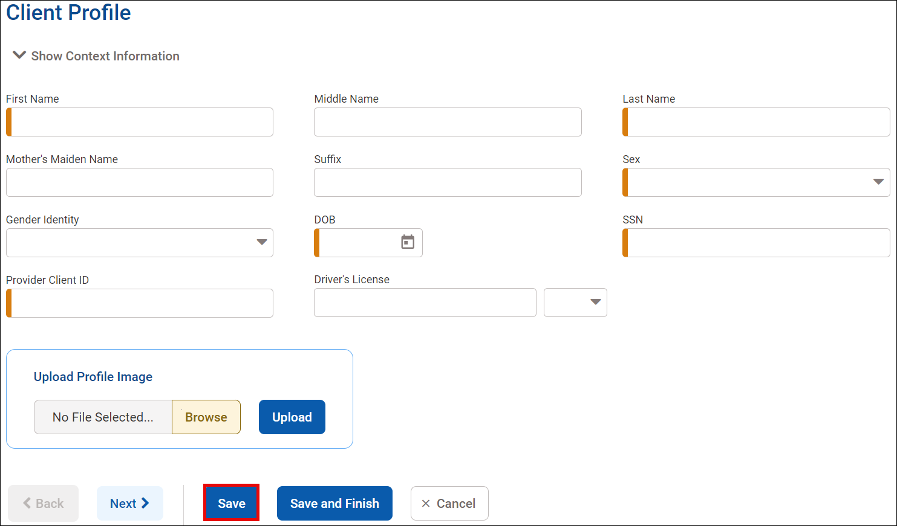
Client Profile
Fields with an orange bar are required to save.
Notes:
You will now be on the client profile screen.
When completing most screens within WITS, you will notice several fields with an orange bar. These are required fields.
You will not be able to save information added on these screens until all required fields are completed.

Slide 13
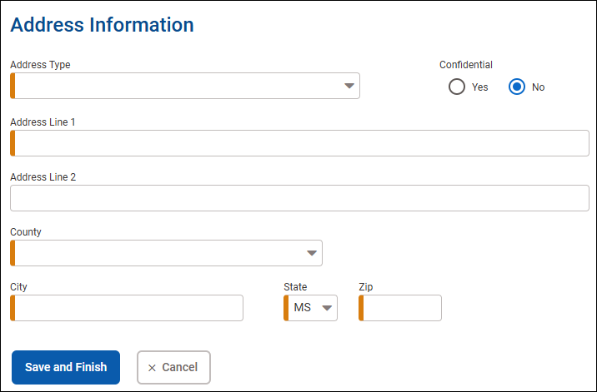
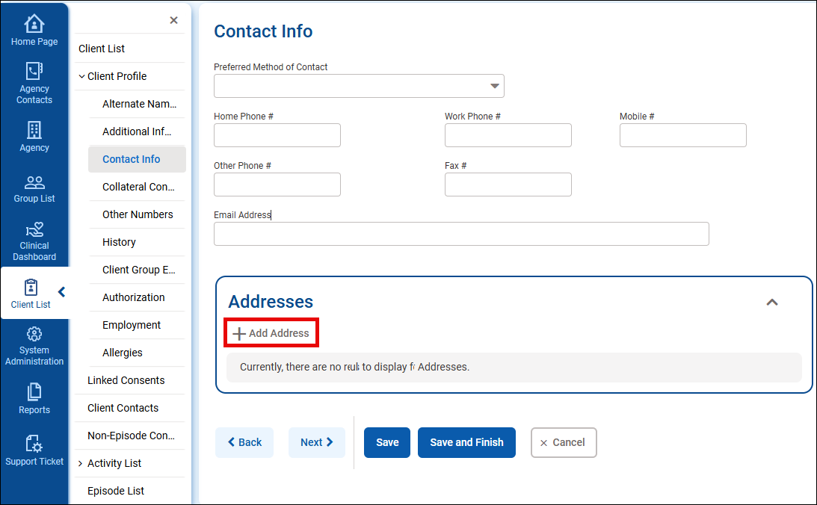
Address
Notes:
Once the client profile is created, you will need to add a phone number for the client.
Click Contact Info under the Client Profile submenu.
Set the Preferred Contact Method to Phone and then enter a number into its respective field.
Save changes once entered.

Slide 14
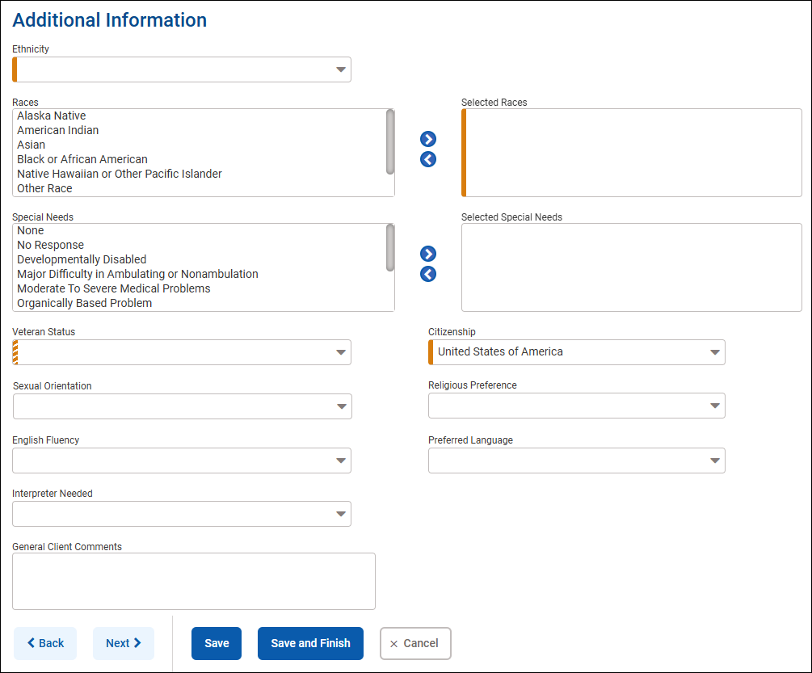
Additional Information
Required
  Orange bar
  Orange candy striped

Slide 15
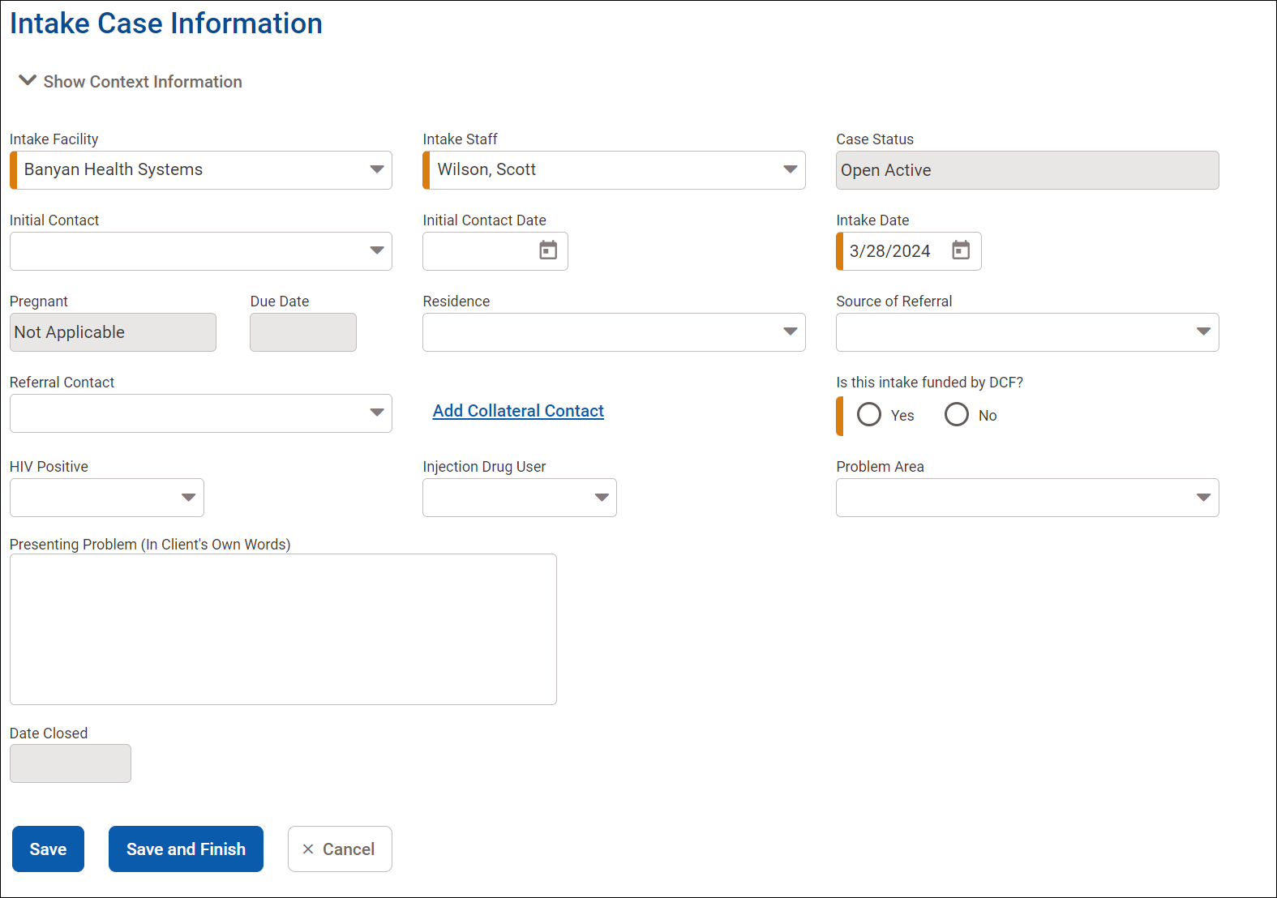
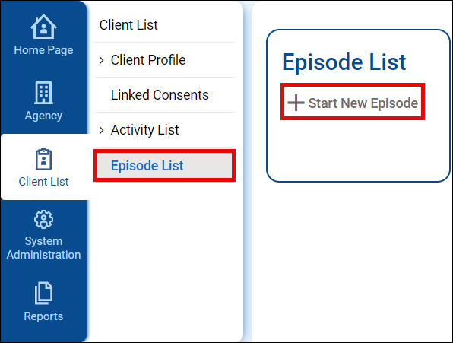
Intake
Notes:
Once the client profile has been created, the intake can be completed.
Click Episode List and then Start New Episode to access the Intake Client Information screen.
Information from the client profile screens will auto populate fields on this screen.
Complete the other required and relevant fields and then click Save and Finish.

Slide 16
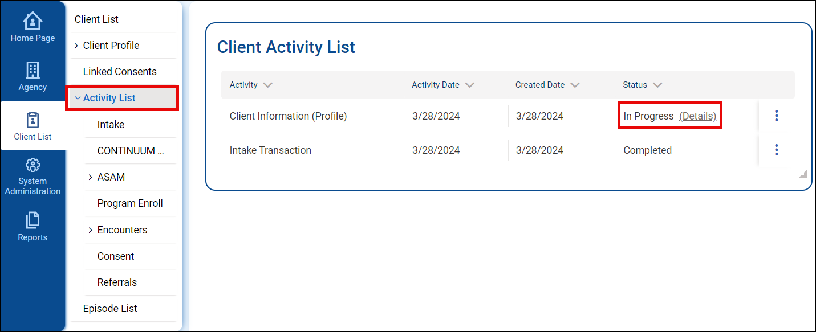
Activity List
Status of In Progress means not all required screens have been completed.
Notes:
Once the intake is completed, The Activity List screen will display.
This screen displays what sections of the client record have been completed.
If any required screens have not been completed, then that section will have a status of In Progress. Clicking Details to the right of the status will inform you of what information still needs to be completed.

Slide 17
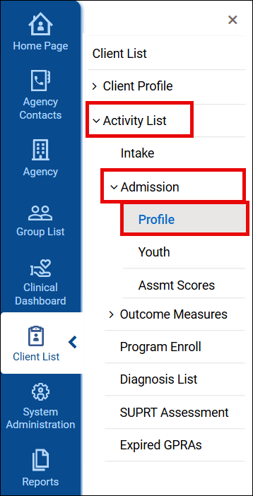
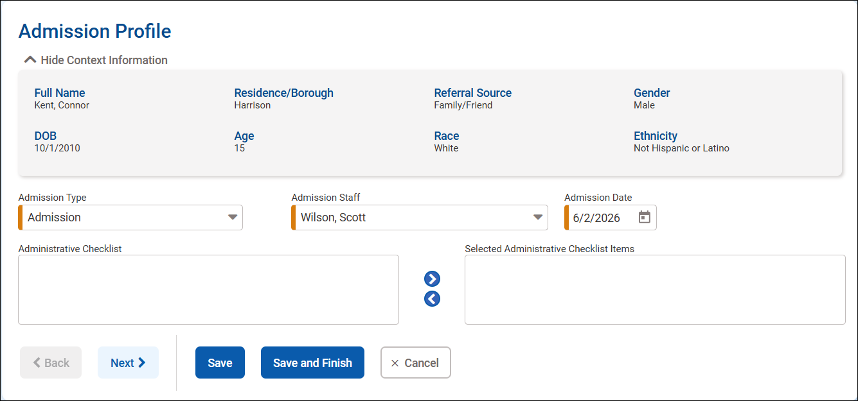
Admission
Notes:
After the intake is completed, navigate to the Admission Profile, by clicking Admission under the Activity List.

Slide 18
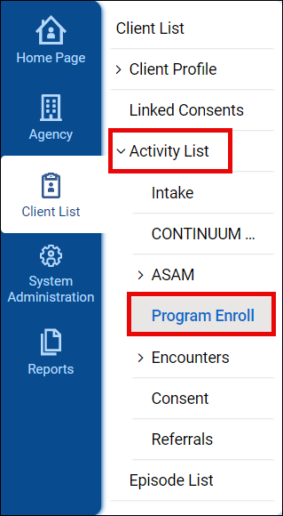
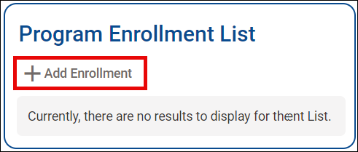
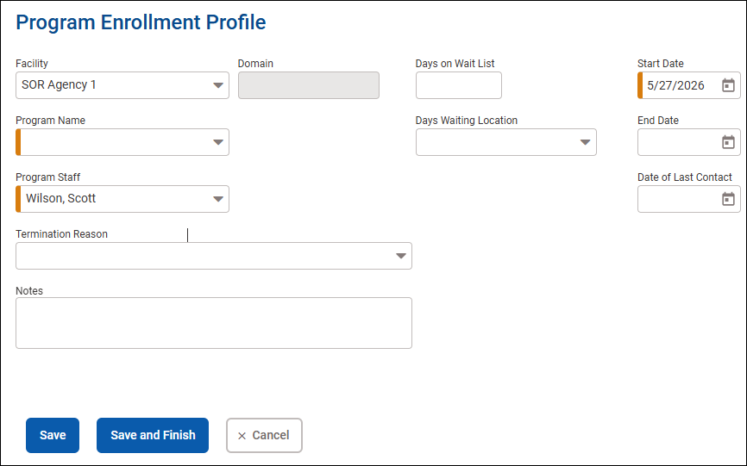
Program Enrollment
Notes:
The next step is to enroll the client into the SOR program.
Click Program Enroll under the Activity List submenu.
Then click Add Enrollment to access the Program Enrollment Profile screen.
Complete the required and relevant fields, and then click Save and Finish.

Slide 19
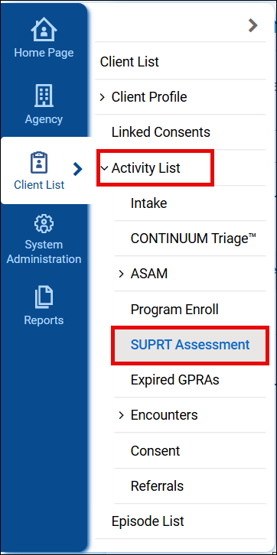
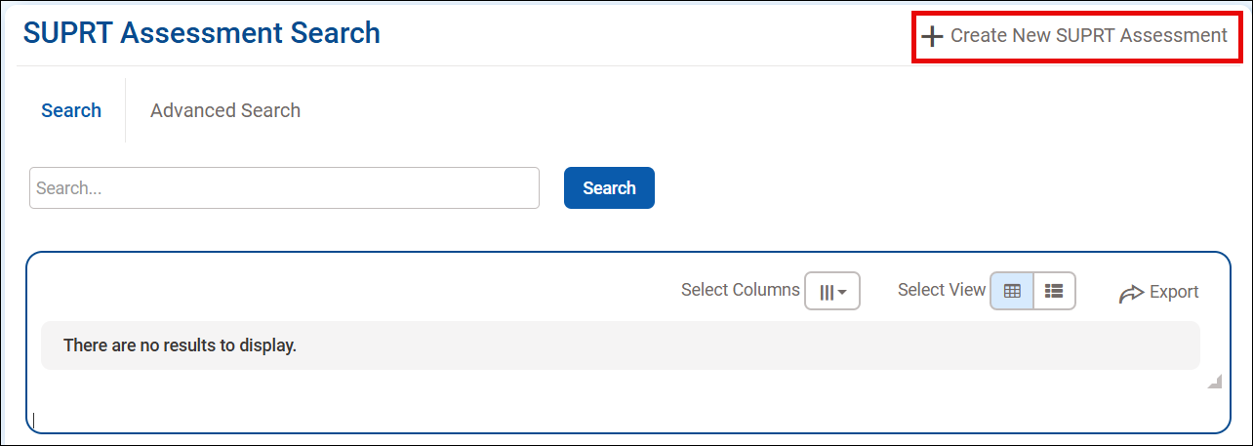
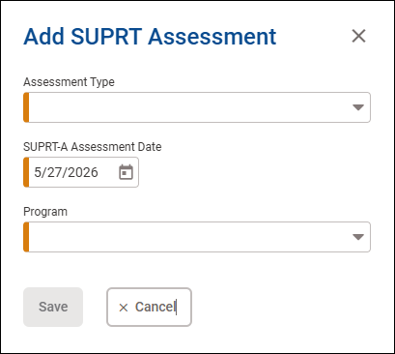
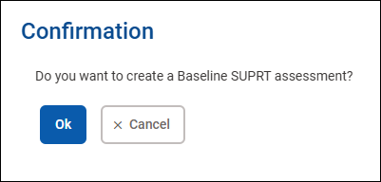
SUPRT Assessment
Notes:
Now that the client has been enrolled in the SOR program, you can access the SUPRT Assessment screen.
Under Activity List’s submenu, click SUPRT Assessment.
On the SUPRT Assessment Search screen, click Create New SUPRT Assessment.
The Add SUPRT Assessment window will open. Set the assessment type. This will be baseline for clients newly added to a program.
Complete the other fields and click Save. A confirmation message will display. Click OK to finish creating the assessment.

Slide 20
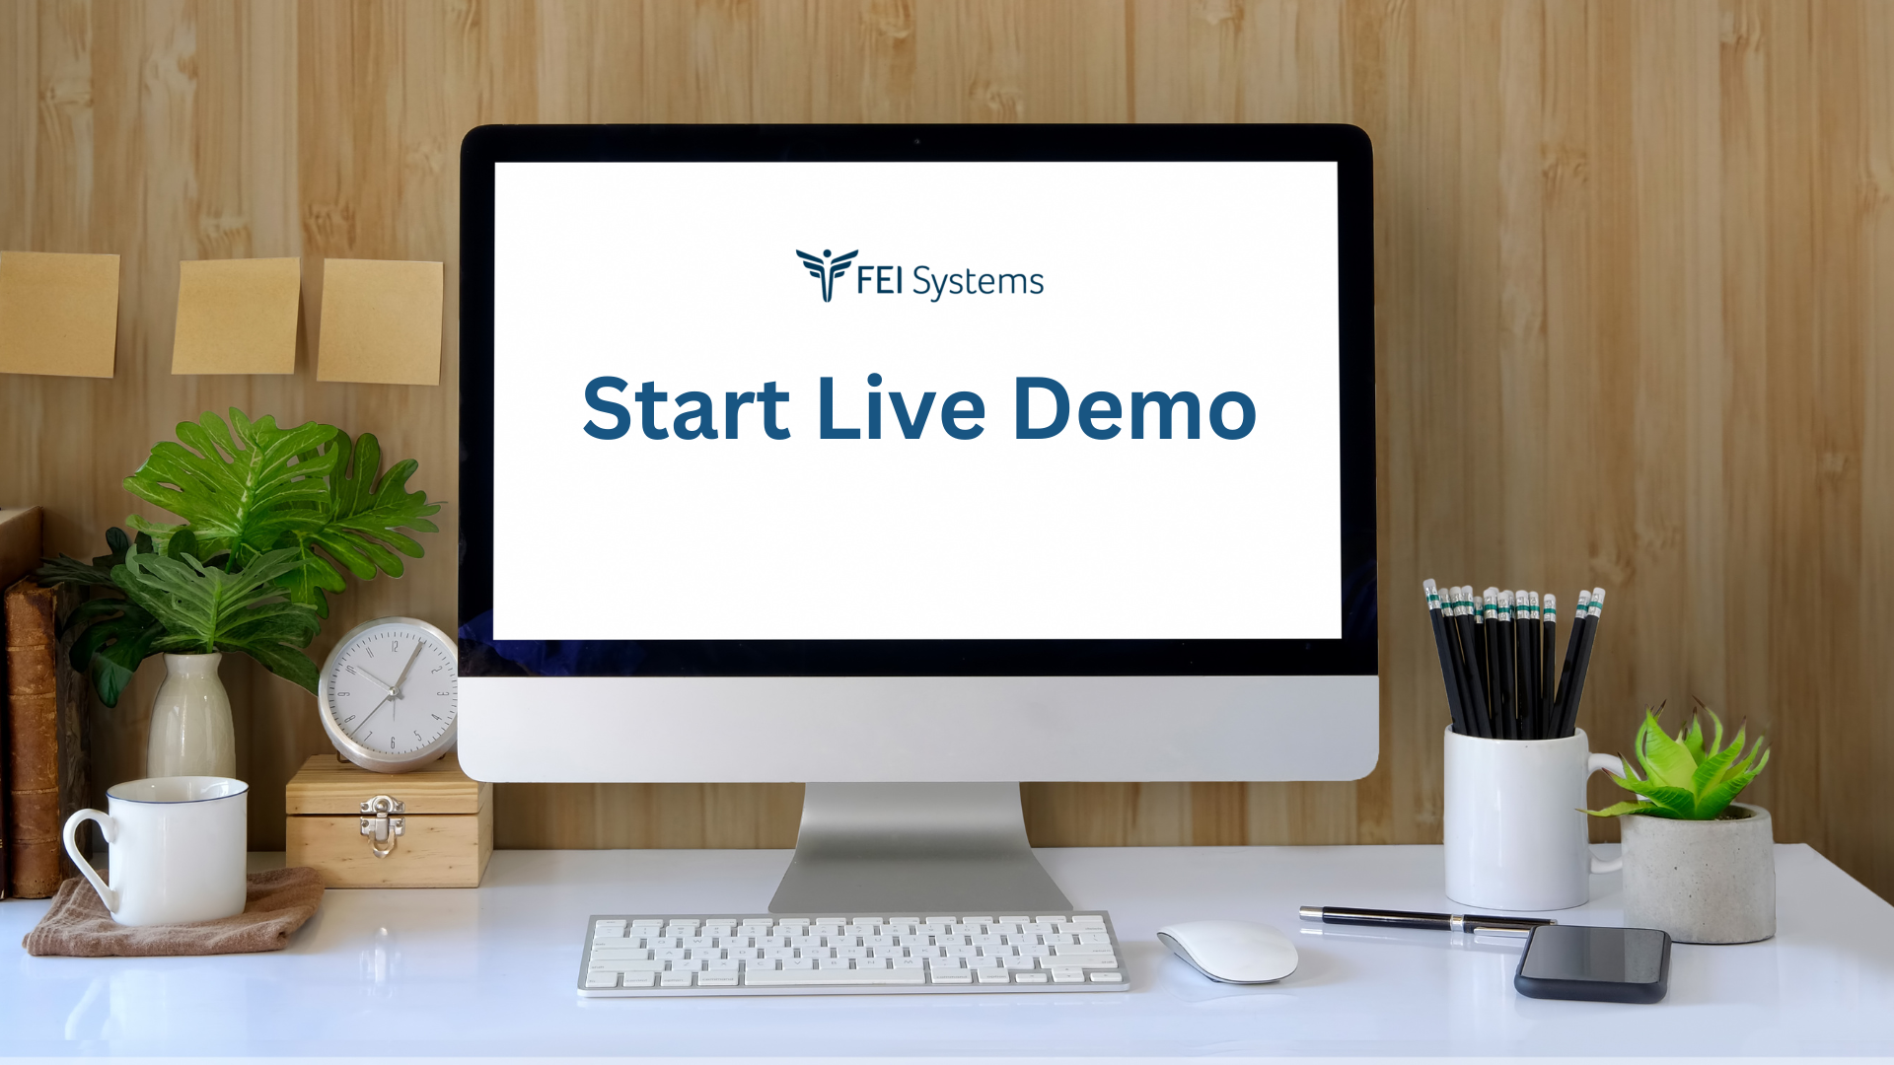
Demo
Notes:
Use Service Provider 1 to demo the following:
Client 1 –
Client 2 –
Create a client record.
Add a phone number
Add a contact
Create an Intake.
Show the Activity List.
Enroll the client to a program.
Create the baseline SUPRT assessment.

Slide 21
SUPRT Assessment
Notes:
We’ve discussed the workflow up to the creation of the GPRA. Now, we will focus our attention on the GPRA.

Slide 22
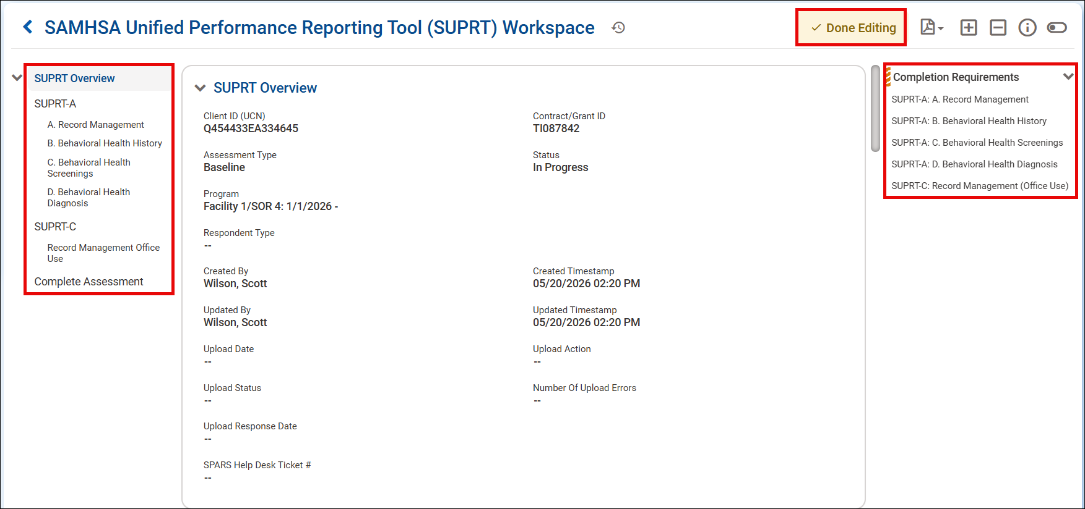
SUPRT Assessment
Notes:
The workspace for the SUPRT Assessment is divided into three main sections.
The left side lists the different sections. Clicking on any section will instantly navigate to it.
The middle section contains the form itself.
The right side of the workspace informs you of any sections that still have completion requirements not met.
At the top of the form is the Edit/Done Editing button. Click this to unlock or lock the workspace.

Slide 23
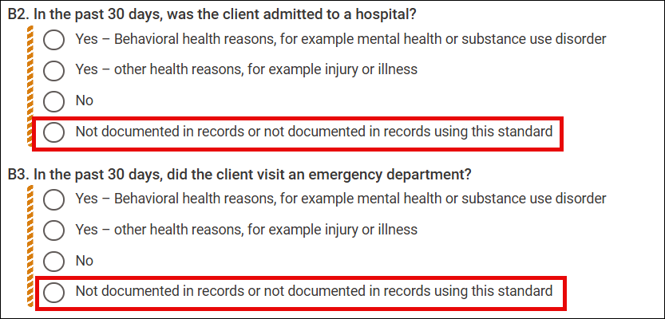
SUPRT Assessment – Not Documented
Select when information not known or available.
Notes:
If information is not available when completing a question, use the option “Not documented in records or not documented in records using this standard.

Slide 24
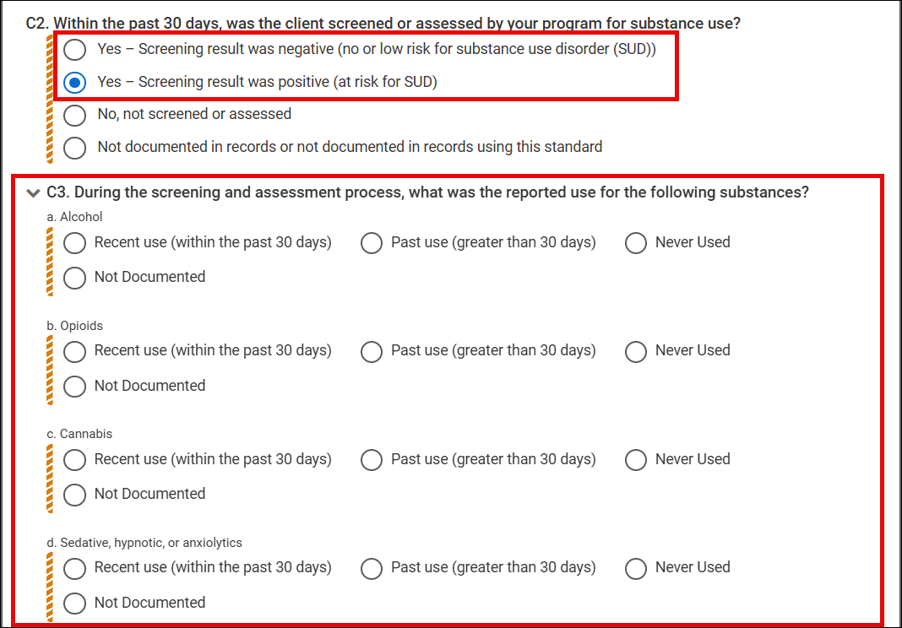
SUPRT Assessment – Required Follow-Up
Answering “Yes” to some questions requires follow-up
For example, answering “Yes” on substance use screening requires all substance use to the identified
Notes:
When some questions are answered as “Yes” follow-up questions will become required.
All follow-up questions must be answered.
For example, answering “Yes” on substance use screening requires all substance use to the identified.

Slide 25
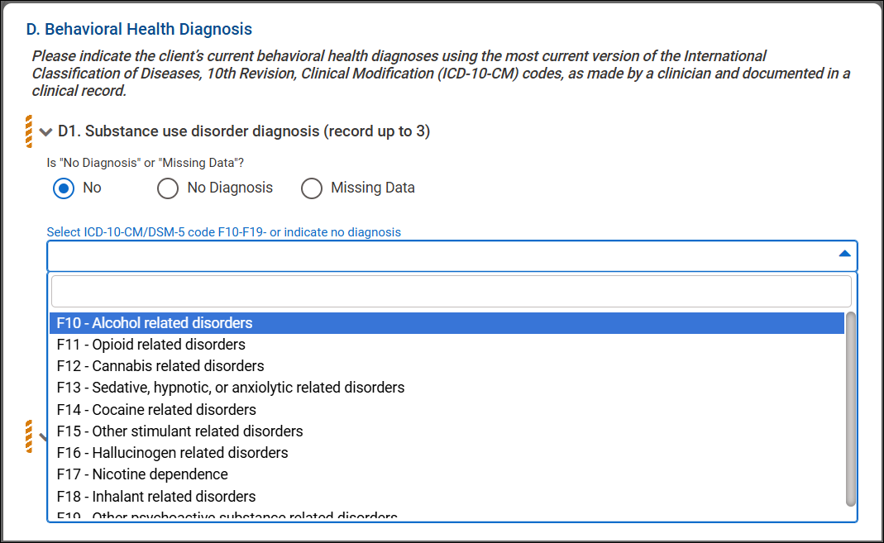
SUPRT Assessment – Diagnosis
Section D – Behavioral Health Diagnosis
Up to 3 diagnoses for each diagnosis type
Scroll or search dropdown list
Notes:
Section D – Behavioral Health Diagnosis allows you to record up to 3 diagnoses for each of the following groups: substance use, mental health, and other factors influencing the client’s health status.
If there are no diagnoses to record, you must answer No Diagnosis or Missing Data.
Otherwise, click in the dropdowns for each applicable diagnosis group and click the diagnosis code.
At least one diagnosis must be added if no is selected for the diagnosis group. However, the other two drop downs can be left blank if there are no other diagnoses.

Slide 26
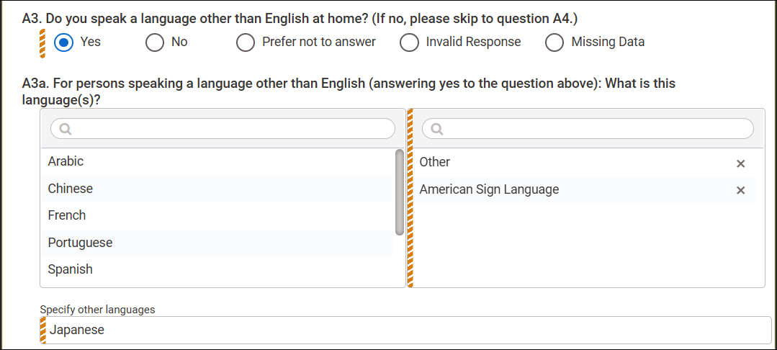
SUPRT Assessment – Mover Boxes and Other
Mover boxes allow for multiple results.
Answer of Other requires follow-up field completion.
Notes:
There are mover boxes that will need at least one option moved to the selected box. To do this, simply click on the option to be moved. To remove an option from the selected box, click on it to move it back to the available list.

Slide 27
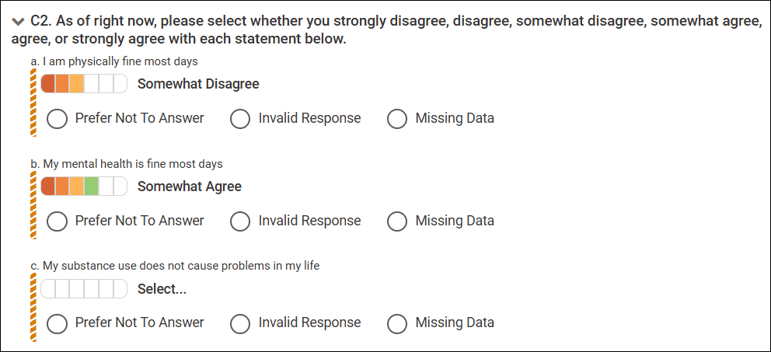
SUPRT-C Assessment – Likert Scale
Use Likert scale to rate the client’s agreement with the statement posed
Update will flip scale to match paper form
Notes:
In the SUPRT-C under client reported core outcomes, are several statements clients will rate from strongly disagree to strongly agree. Hovering over the boxes in the Likert scale will display the response. Just click on the applicable level of agreement to answer.

Slide 28
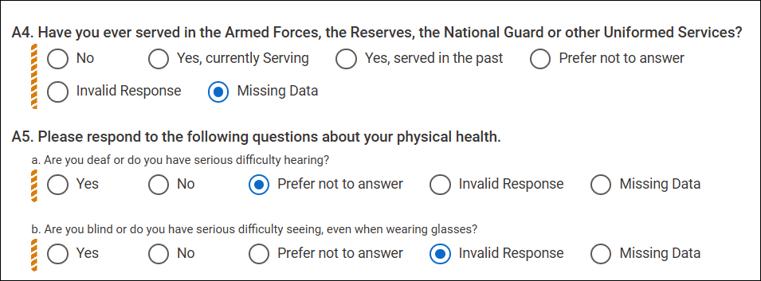
SUPRT-C Assessment – Invalid or Missing Data
Missing Data – Selected if client did not answer the question
Prefer not to Answer – Selected if the client did not or refused to provide answer
Invalid Response – Selected when the client provided too many answers or provided an otherwise invalid response
Notes:
While completing the SUPRT-C, the client/proxy will be asked to answer several questions. It is not required for them to answer every question.
If the client does not answer a question, you will mark the question as Missing Data if the client provided no answer. This is not the same as the response “Prefer not to answer” where the client stated they did not want to provide an answer to the question.
If the client marks more than one answer on a question with only one possible response, then you will mark the question as an Invalid Response. Do not guess at which answer the client meant when answering the question.

Slide 29
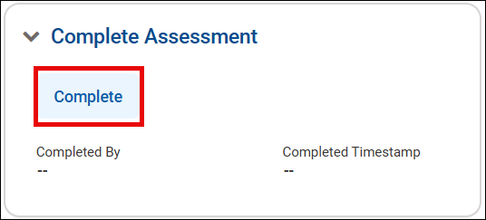
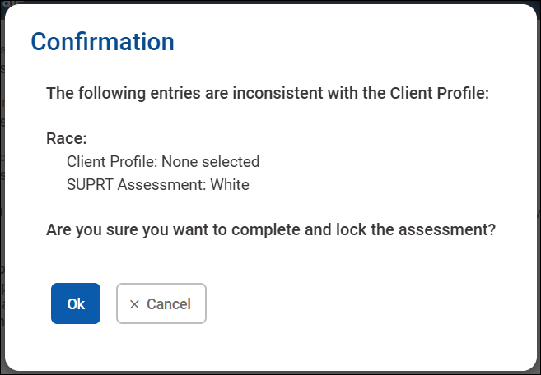
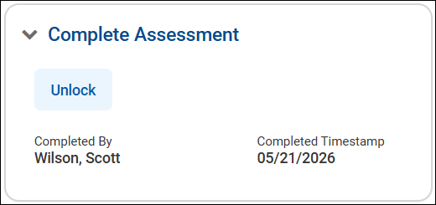
Completing Assessment
Notes:
Once all completion requirements have been met, the assessment can be completed.
Click the Complete button and confirm that you want to complete and lock the assessment.
Notice, that WITS will check recorded information in its system and compare to answers provided in the assessment. If there are any discrepancies, WITS will alert you. You can then correct the information or continue completing the assessment.
Once confirmed, the assessment will now have a time stamp of who and when the assessment was completed.

Slide 30
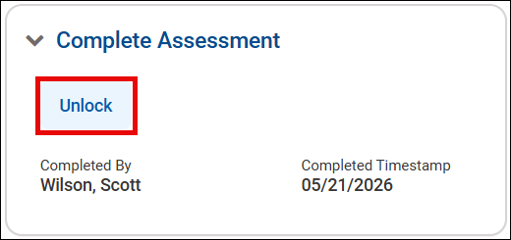
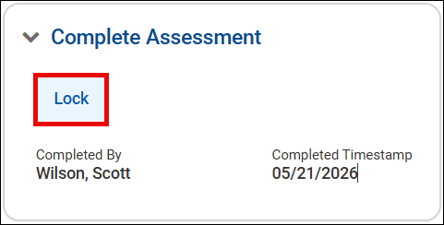
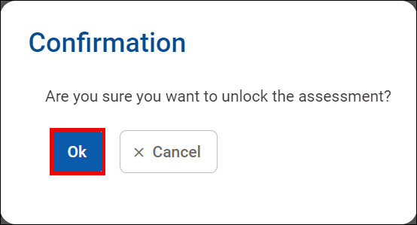

Unlock Assessment
Assessment must be unlocked to make edits
Lock assessment after edits made
Notes:
If any edits need to be made to the assessment, click Unlock at the bottom of the assessment and confirm that you want to unlock the assessment.
Make the needed changes and then click Lock once edits are complete. Again, you will need to confirm the selection.
The assessment must be in the locked status for the SUPRT to upload to SPARS.

Slide 31
Demo
Notes:
Demo the following:
Use Kara Danvers and Garfield Logan
Show the different sections of the GPRA.
Answer Alcohol and Opioid sections
Answer No to Alcohol Use Disorder
Answer Yes to Opioid Use Disorder
Answer Refused to Stimulant Disorder
Answer Missing Data to Tobacco Use Disorder
Answer yes to metal health illness
Choose a Modality
Choose at least one service
Answer Yes to being arrested
Complete the GPRA
Unlock and the lock the GPRA

Slide 32
Reassessment and Annual Assessment
Notes:
So long as the client is receiving service, a GPRA follow-up assessment will need to be completed every 6 months.

Slide 33
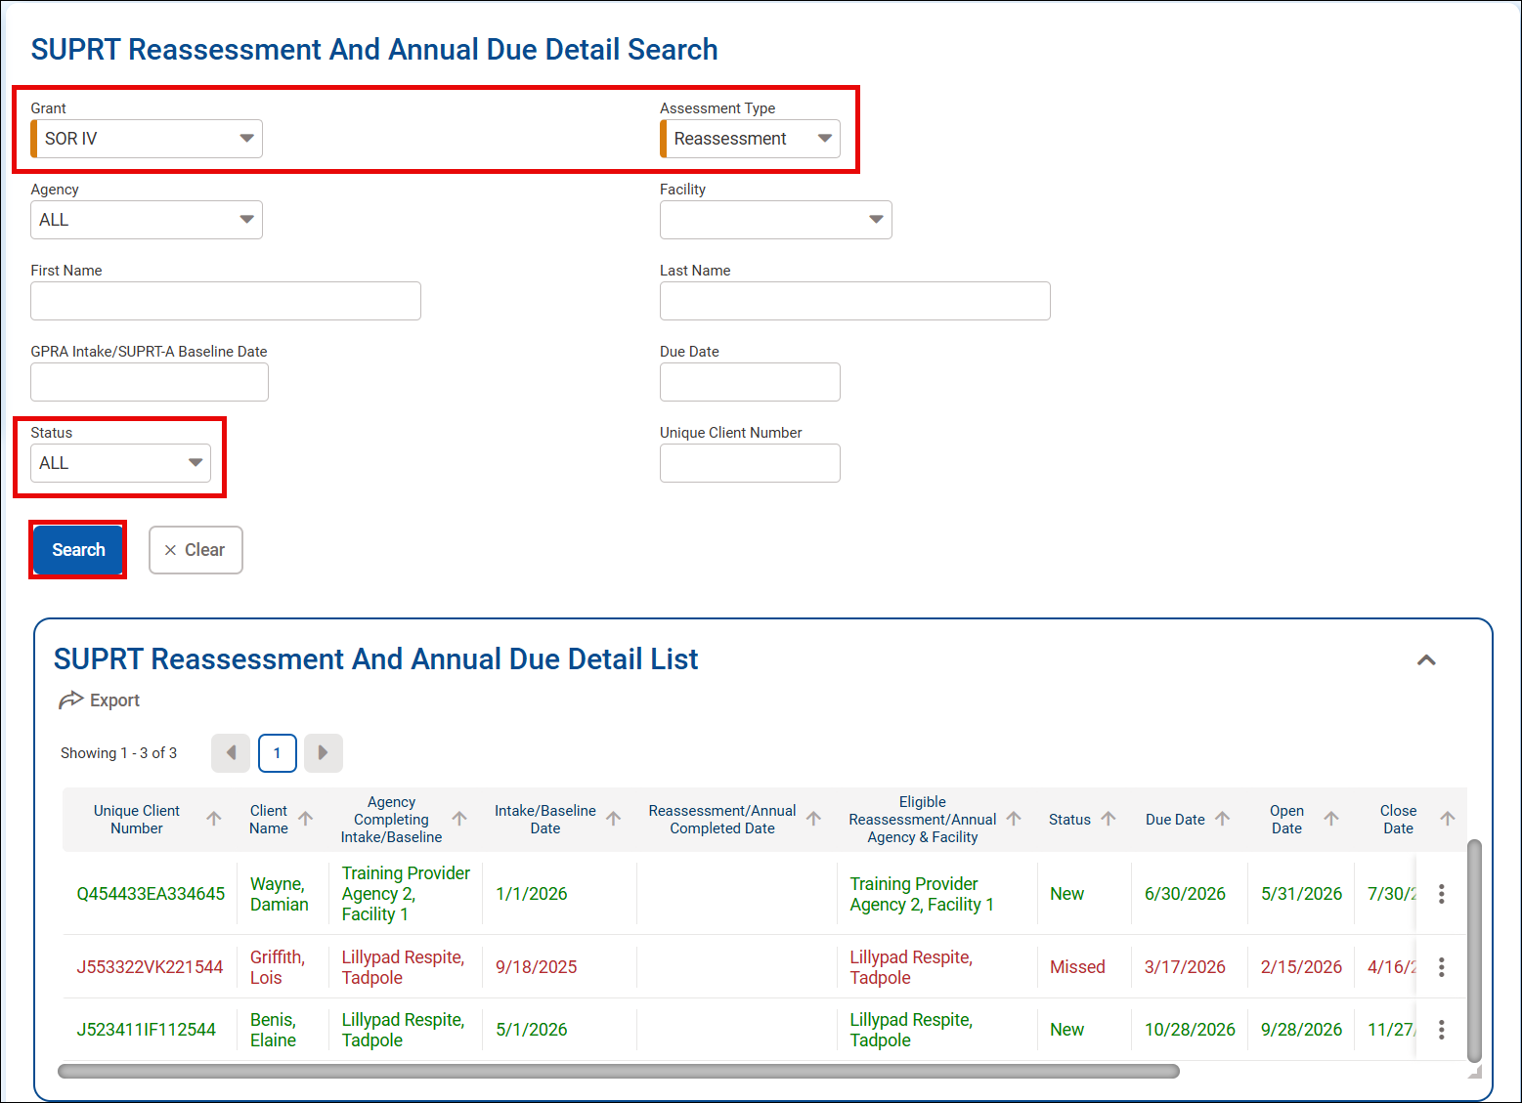
SUPRT Reassessment and Annual Due Detail
Clients in green are new and/or within window.
Clients in red mean their reassessment or annual assessment window was missed.
Notes:
There is a SUPRT Reassessment and Annual Due Detail report that providers can run to manage the status of upcoming reassessments and annual assessments.
When running the report, you will need to set the Grant and the assessment type. There are other fields that can be selected as well, but they are not required.
One of those fields is the Status, which can be used to identify those assessments that are within or past the window.

Slide 34
Reassessment
Due 6 months after baseline assessment
Completion window – 30 days before and after baseline anniversary
SUPRT-A
  Section E Services Received added
  Section F Demographics removed
SUPRT-C
  Demographics removed
Notes:
As a reminder, the reassessment is due either 3 or 6 months after the baseline assessment. The state determines if it is 3 or 6 months.
The window for completing the reassessment opens 30 days before and closes 30 days after the baseline anniversary.

Slide 35
Annual Assessment
Due 12 months after baseline assessment and every 12 months after
Completion window – 30 days before and after baseline anniversary
SUPRT-A
  Section E Services Rendered added
  Section F Demographics removed
SUPRT-C
  Only for clients in adult category at Baseline
  Only Record Management and Client Reported Core Outcomes
Notes:
The annual assessment is due 12 months after the baseline and every 12 months thereafter. The window opens 30 days before and closes 30 days after the anniversary date.
In SUPRT-A, services rendered is added and demographics is removed.
If the client’s baseline assessment had the client listed in the adult category, then SUPRT-C is available for the client to complete.
It will consist of only Record Management and Client Reported Core Outcomes.

Slide 36
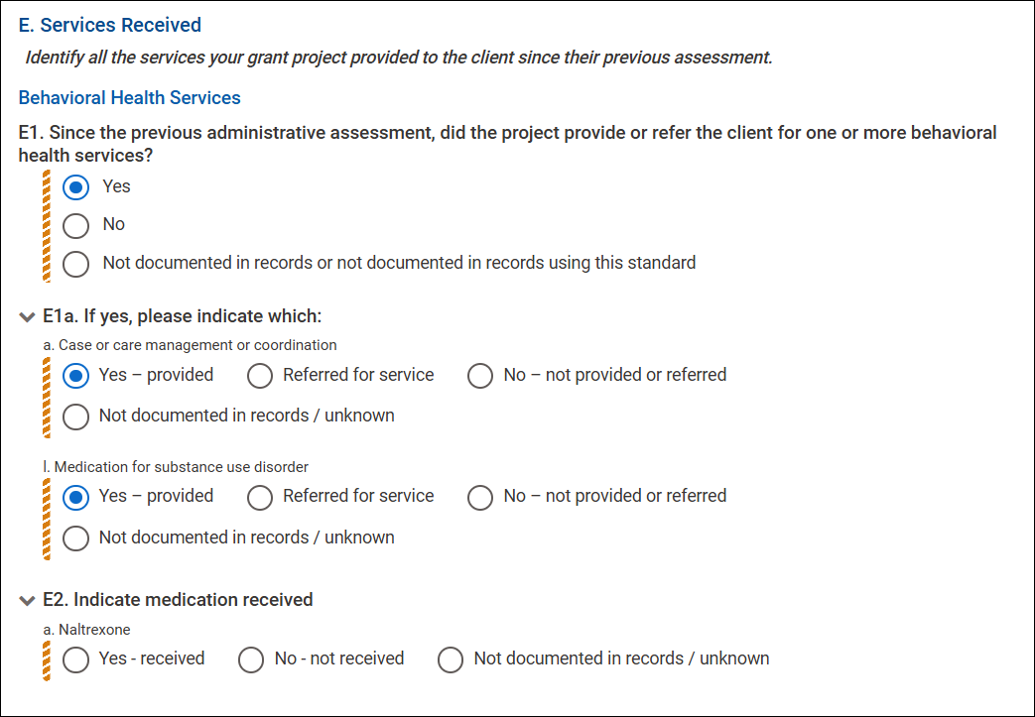
Services Rendered
4 service groups
Yes in any group = Answer all follow-up
Medication for substance use must be Yes to record medications in E2.
Notes:
After the baseline assessment, section E. Services Rendered will be added to the reassessment, annual, and close out assessments.
Here, you identify all the services the client received. These services are divided among the groups: behavioral health, crisis, recovery and support, and integrated services.
If Yes is selected for any group, all the follow-up questions must be answered.
Question E2 asks about the medications prescribed for substance use disorder. To record these medications, E1 – L must be set to Yes.

Slide 37
Demo
Notes:
Demo the following:
Use Kara Danvers and Garfield Logan
Create the 6 month follow up with interview.
Show the new sections.

Slide 38
Closeout Assessment
Notes:
Once the client is no longer receiving services, the closeout assessment is recorded.

Slide 39
Closeout Assessment
No longer receiving services
Completed within 30 days after services discontinued
Reassessment and Annual no longer needed
SUPRT-A
  Section A – Record Management
  Section E – Services Received
SUPRT-C is not completed
Notes:
The closeout assessment is completed when services for the client is discontinued for any reason. The closeout assessment must be completed within 30 days services were discontinued.
Once the closeout assessment is completed, no further assessments are required, even if within a window.
The assessment will only consist of the sections A and E in the SUPRT-A, and the SUPRT-C assessments is not offered.

Slide 40
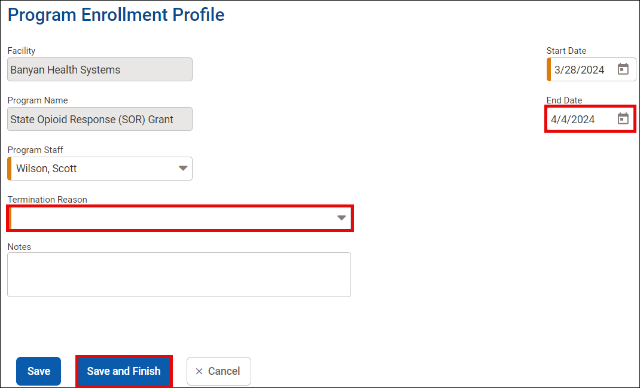
Discharge – Close Program Enrollment
Set End Date
Provide Termination Reason
Notes:
If the client is no longer enrolled in the SOR program associated with the SUPRT assessments, you will end the program enrollment. In the Program Enrollment Profile, enter the End Date and Termination reason. Click save and finish to complete disenrollment.

Slide 41
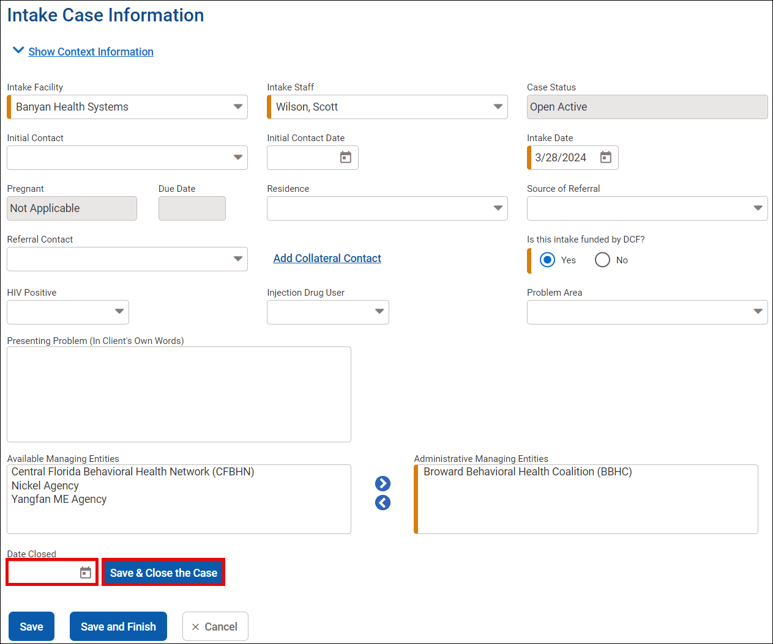
Discharge – Close Intake
Set Date Closed
Save & Close the Case
Notes:
If the client’s episode of care is ending, then you will also need to close the intake.
Within the intake case information screen, scroll to the bottom of the screen, complete the Date Closed field, and then click Save and Close the Case.

Slide 42
Demo
Notes:
Demo the following:
Use Nathan Summers and Donna Troi
Complete the discharge GPRA.
Discharge from program.
Close Intake.

Slide 43
GPRA to SUPRT Transition
Notes:
Finally, let’s look at how you will transition existing clients from the GPRA to the SUPRT assessments.

Slide 44
GPRA to SUPRT Transition
SUPRT Baseline is not completed if GPRA Intake completed
  Unless new episode of care opened for client
SUPRT-C still voluntary for client
Reassessment and Annual due based on GPRA Intake completion date
Closeout Assessment completed when services end
Notes:
Transition from GPRA to SUPRT will be easy.
First, the SUPRT baseline is not completed if there is a completed GPRA Intake. If a new episode of care is started for the client, then the Baseline would be completed then.
The SUPRT-C is still voluntary for the client to complete.
The Reassessment and Annual Assessments will be due based on the completion date of the GPRA Intake.
The Closeout Assessment will be completed when services end.

Slide 45
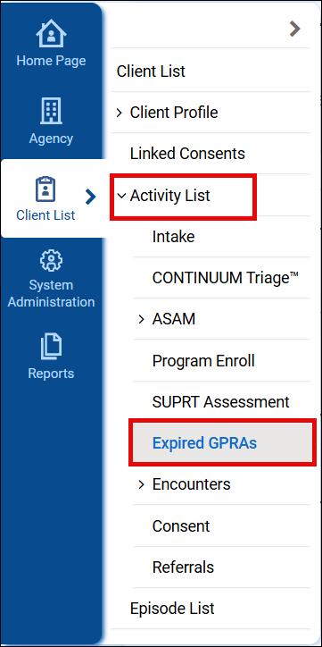
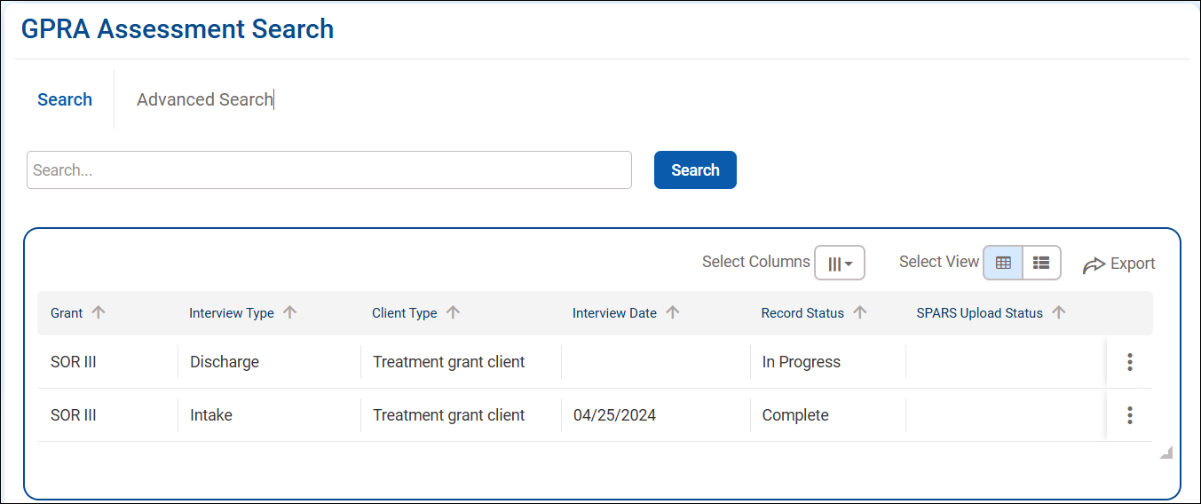
Expired GPRAs
Notes:
With the transition to the SUPRT assessments, all GPRAs will be moved to the Expired GPRA screen. This includes GPRAs that are still being completed.
To view the GPRA, navigate to Expired GPRAs located under the Activity List.

Slide 46

Questions?

Slide 47

Survey
Please take a moment to access the link below and complete the short survey.
https://www.surveyhero.com/c/SOR4Prov
Notes:
https://www.surveyhero.com/c/SOR4Prov

Slide 48
Thank You!

